Slide 1
Java Swing - An Introduction
Prepared By:
Rohtash Singh
R Systems International Ltd.

Slide 2
Overview
Swing Basics
Components and Containers
Layout Management
Event Handling and Listeners
Graphics with Swing
Problem Class Session
Continue…..

Slide 3
Continue…
Java GUI Classes
Creating a GUI
Elements of a GUI
Component (items displayed (widgets))
Container (region containing components
Layout (arrangement of components)
Event (interactions for GUI)

Slide 4
Before we Start… (1)
Swing is all Java.
You must know about, and understand:
  Classes / Objects
  Method Overloading
  Inheritance
  Polymorphism
  Interfaces

Slide 5
What is Swing?
A part of The Java Foundation Classes
  Swing
    Look and feel
    Accessibility
    Java 2D (Java 2 onwards)
    Drag and Drop
    etc
Can be used to build Standalone Apps as well as Applets

Slide 6
Getting started with Swing (1)
Compiling & running programs
  Swing is standard in Java 2 (JDK >= 1.2)
  Use:
    ‘javac <program.java>’ && ‘java <program>’
    Or IDE (Integrated Development Environment)

Slide 7
Getting started with Swing (3)
Swing, like the rest of the Java API is subdivided into packages:
  javax.swing,javax.swing.border, etc…
At the start of your code - always
  import javax.swing;
  import javax.swing.event;
Most Swing programs also need
  import java.awt.*;
  import java.awt.event.*;

Slide 8
Differences between Swing and AWT (1)
Never mix Swing and AWT components
If you know AWT, put ‘J’ in front of everything
  AWT: Button
  Swing: JButton
Swing does all that AWT does, but better and there’s much more of it.

Slide 9
Differences between Swing and AWT (2)
Buttons and labels can display images
Behaviour and appearance of components
Component shape
Borders
Look and feel of the program’s GUI
  Windows – (but only on Windows)
  UNIX
  etc

Slide 10
A typical Swing program
Consists of multiple parts
  Containers
  Components
  Events
  Graphics
Now look at each in turn

Slide 11
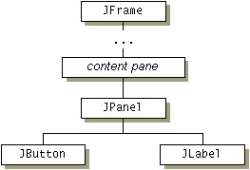
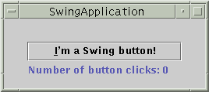
A simple Swing program - Containers
Containers

Slide 12
Remember this about Containers:
The structure of containers is your design decision and should always be thought through in advance
  particularly for managing components
  nesting containers
Failure to do so usually either results in a messy interface, messy code or both.

Slide 13
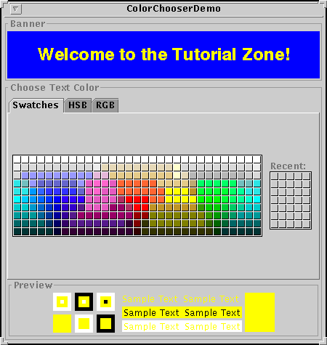
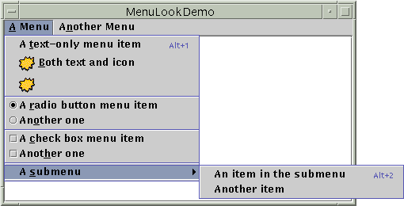

A simple Swing program - Components
Components

Slide 14
Remember this about Components:
There are many components that make your job much easier.
Often, you will be able to customise an existing Swing component to do a job for you, instead of having to start from scratch
  E.g. can extend (inherit from) the JButton class and ‘paint’ a new button over the top

Slide 15
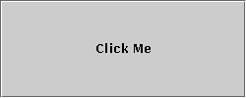

A simple Swing program - Events
Events

Slide 16
Remember this about events:
‘Events’ as seen by GUIs do not happen all that often in an application
Consider what is happening between events as well as during them

Slide 17











A simple Swing program - Graphics
Graphics
Complex drawing and
shading API.
Can do far more than
display images.

Slide 18
A simple Swing program - Threads
Most simple Swing GUI applications don’t require use of any (extra) threads
As Swing creates event-driven programs, all code is executed on the event-dispatching thread

Slide 19
Event Dispatching Thread:
  Example code
    Allows current thread to execute GUI code indispatching thread
    createAndDisplayGUI
      Method that actually defines the GUI
  javax.swing.SwingUtilities.invokeLater(new Runnable( ) {
    public void run( ) {
      createAndDisplayGUI( );
    }
  });
  The single-thread rule
  “Once a Swing component has been realized, all code that might affect or depend on the state of that component should be executed in the event-dispatching thread”

Slide 20
How to create a GUI
Define Frame or Applet to hold components
  We’ll just use frames for now
Add GUI components to Frame
  Use layout manager to determine position
3. Add actions to GUI
  By adding event listeners to GUI components

Slide 21
JFrame Hierarchy
Several super classes
  As well as implemented interfaces
Many, many member methods
  Including inherited methods that allow
    Resizing
    Setting properties
    Adding components,
    Etc…
Other top level containers
  JDialog (dialog boxes)
  JApplet (web applets)
  JWindow (stripped down JFrame, no title bar or window buttons)
Object ← Component ← Container ← Window ← Frame ← JFrame

Slide 22
Layout Manager
A layout manager is an object that implements the LayoutManager interface and determines the size and position of the components within a container.
Types of Layout Managers
  Flow Layout
  Grid Layout
  Border Layout
  Card Layout
  GridBag Layout

Slide 23
Types Layout Managers
FlowLayout
  FlowLayout is the default layout manager for every JPanel. It simply lays out components in a single row, starting a new row if its container is not sufficiently wide.
  Lays out components from left to right
GridLayout
  Lays out components in a grid of user specified size
BorderLayout
  Designates portions of the container as North, South, East, West, and Center
CardLayout
  Adds components one on top of another
GridBagLayout
  Customizable manager that can use rows and columns of varying lengths

Slide 24
GridBag Constraints
gridx, gridy
  Specify the row and column at the upper left of the component. The leftmost column has address gridx=0 and the top row has address gridy=0.
gridwidth, gridheight
  Specify the number of columns (for gridwidth) or rows (for gridheight) in the component's display area. These constraints specify the number of cells the component uses, not the number of pixels it uses. The default value is 1.
  Note: GridBagLayout does not allow components to span multiple rows unless the component is in the leftmost column or you have specified positive gridx and gridy values for the component.
fill
  Used when the component's display area is larger than the component's requested size to determine whether and how to resize the component. Valid values (defined as GridBagConstraints constants) include NONE (the default), HORIZONTAL (make the component wide enough to fill its display area horizontally, but do not change its height), VERTICAL (make the component tall enough to fill its display area vertically, but do not change its width), and BOTH (make the component fill its display area entirely).

Slide 25
GridBag Constraints
ipadx, ipady
  Specifies the internal padding: how much to add to the size of the component. The default value is zero. The width of the component will be at least its minimum width plus ipadx*2 pixels, since the padding applies to both sides of the component. Similarly, the height of the component will be at least its minimum height plus ipady*2 pixels.
insets
  Specifies the external padding of the component -- the minimum amount of space between the component and the edges of its display area. The value is specified as an Insets object. By default, each component has no external padding.
anchor
  Used when the component is smaller than its display area to determine where (within the area) to place the component. Valid values (defined as GridBagConstraints constants) are CENTER (the default), PAGE_START, PAGE_END, LINE_START, LINE_END, FIRST_LINE_START, FIRST_LINE_END, LAST_LINE_END, and LAST_LINE_START.

Slide 26
GridBag Constraints
weightx, weighty
  Specifying weights is an art that can have a significant impact on the appearance of the components a GridBagLayout controls. Weights are used to determine how to distribute space among columns (weightx) and among rows (weighty); this is important for specifying resizing behavior. Unless you specify at least one non-zero value for weightx or weighty, all the components clump together in the center of their container. This is because when the weight is 0.0 (the default), the GridBagLayout puts any extra space between its grid of cells and the edges of the container.
  Generally weights are specified with 0.0 and 1.0 as the extremes: the numbers in between are used as necessary. Larger numbers indicate that the component's row or column should get more space. For each column, the weight is related to the highest weightx specified for a component within that column, with each multicolumn component's weight being split somehow between the columns the component is in. Similarly, each row's weight is related to the highest weighty specified for a component within that row. Extra space tends to go toward the rightmost column and bottom row.

Slide 27
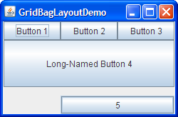
GridBag Demo

Slide 28
Questions
If any?

